Slide 1


Multiscale Adaptive Scheduling and Path-Planning for Power-Constrained UAV-Relays via SMDPs
Paper #1433 | 2022 Asilomar Conference on Signals, Systems, and Computers
Bharath Keshavamurthy and Nicolò Michelusi
School of Electrical, Computer and Energy Engineering
Arizona State University, Tempe, AZ
This work has been funded by NSF under grant CNS-2129015.

Slide 2
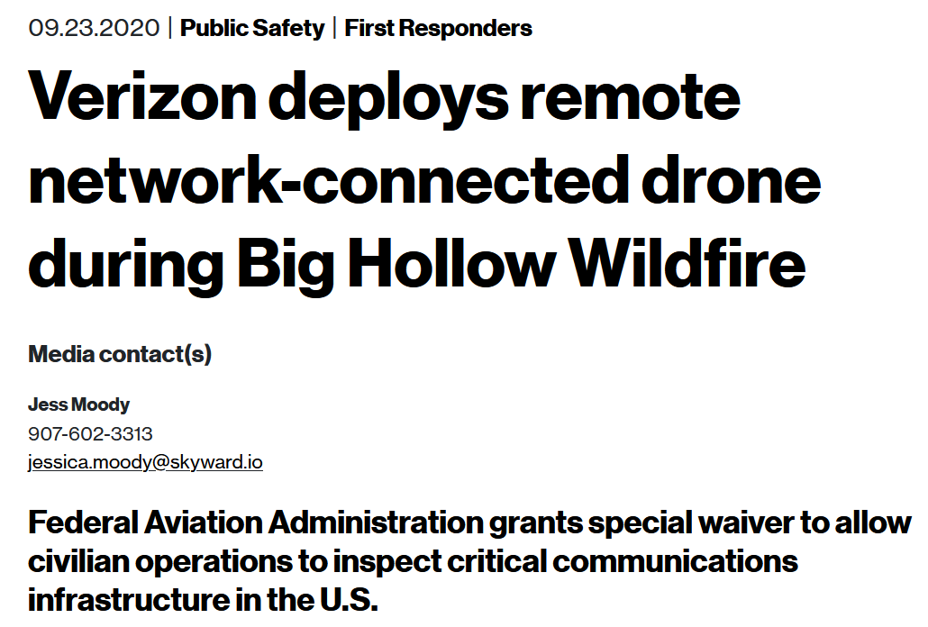
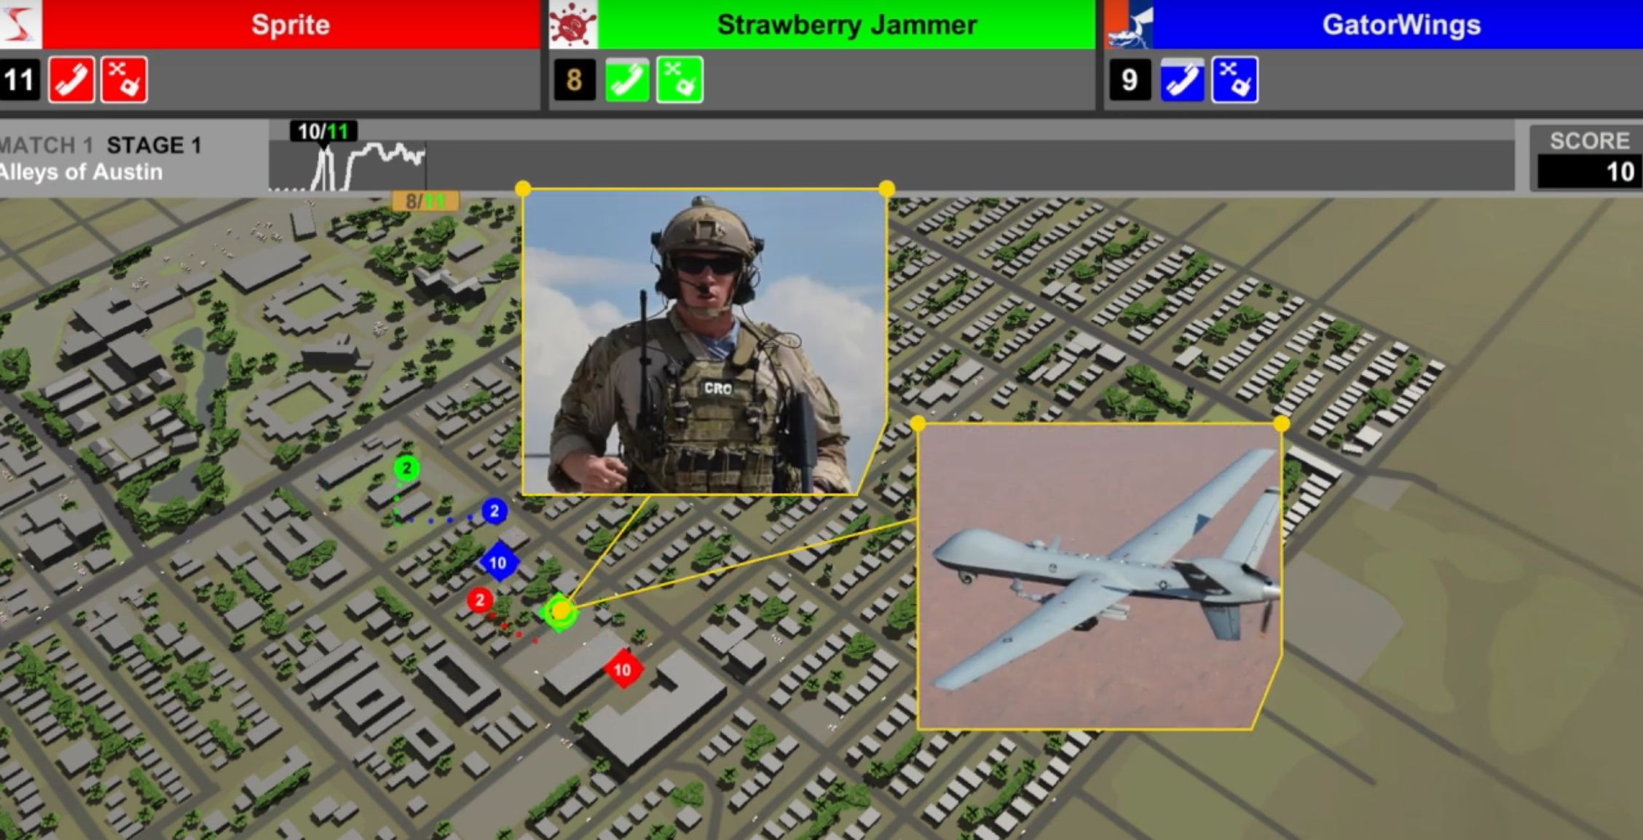
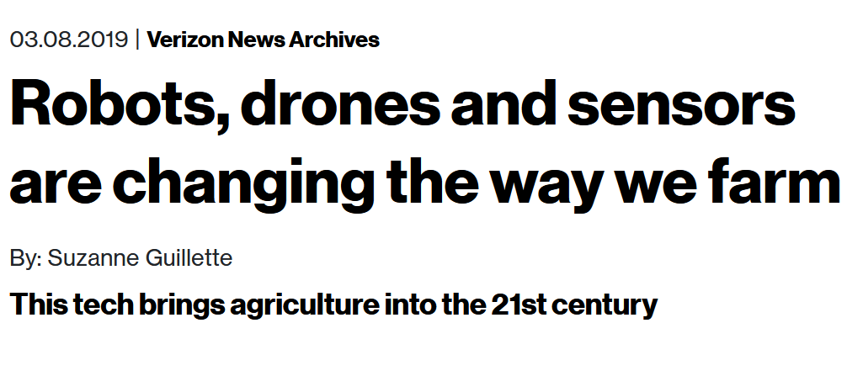

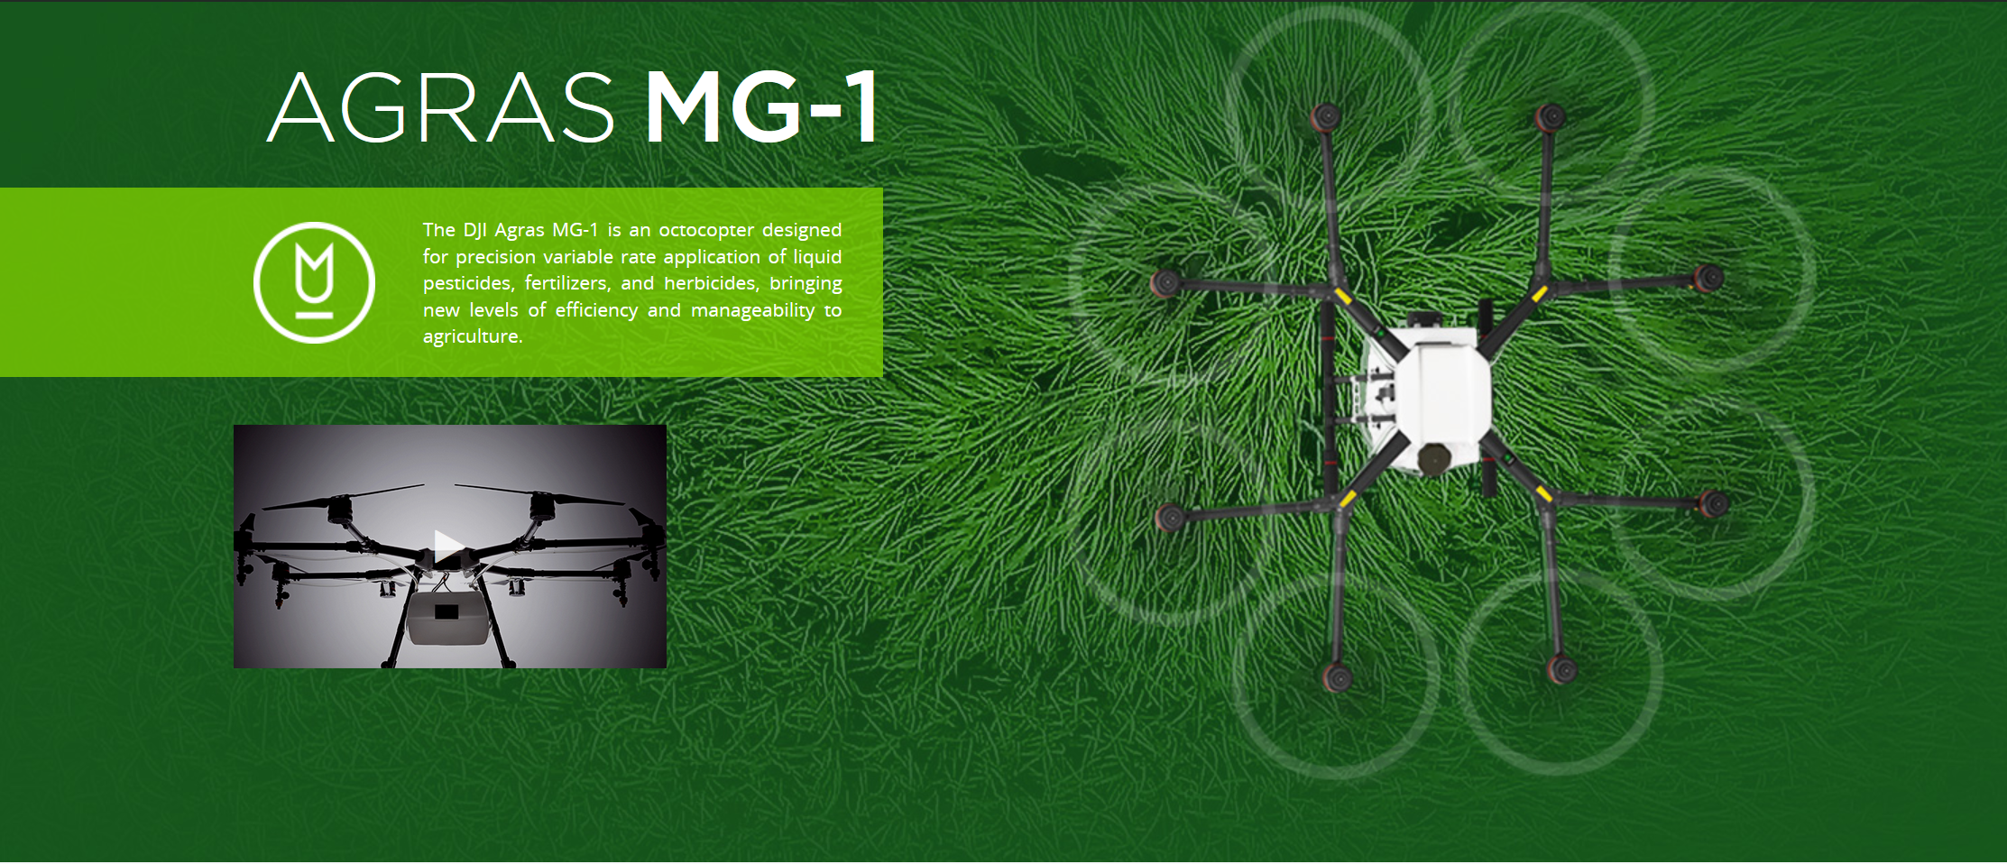
3D Mobility & Maneuverability of UAVs are leveraged in:
Military deployments
Disaster-Relief
Precision Agriculture
URLLC QoS guarantees in Industrial IoT
Why UAVs?

Slide 3

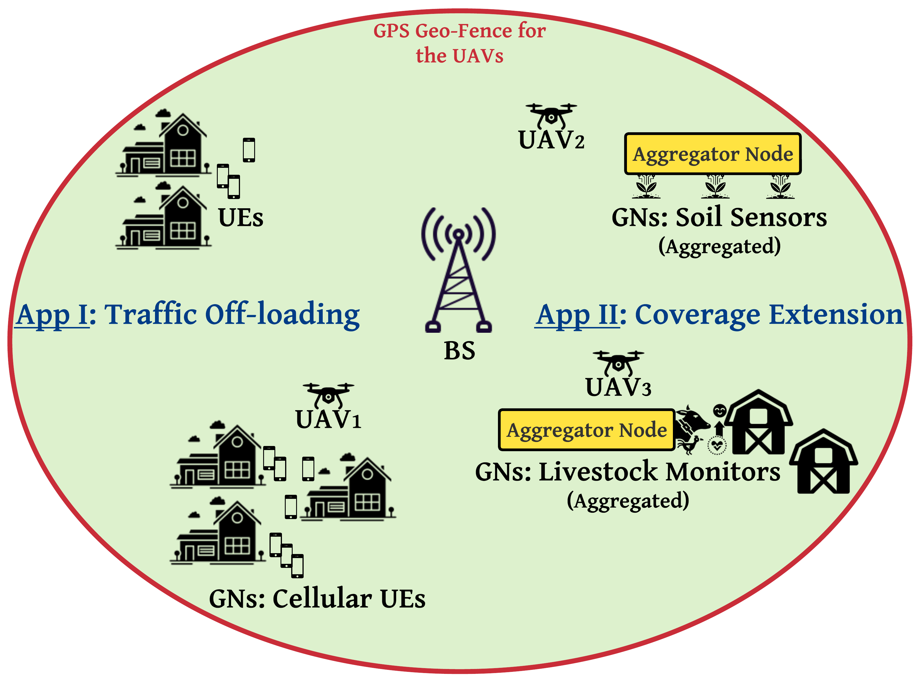
Deployment: Orchestrating a swarm of UAVs serving as cellular relays, augmenting a terrestrial BS
Objective: Optimizing service delays experienced by GNs vs on-board UAV energy constraints

Slide 4
Questions
How do UAV relays assist in improving service latencies in terrestrial networks?

Slide 5
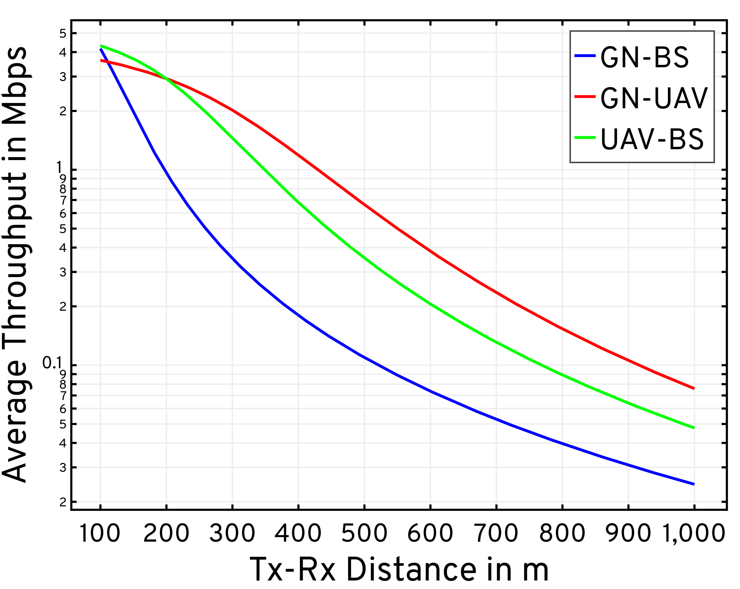
BS height = 60 m | UAV height = 200 m | BW = 1 MHz
GNs farther away from the BS experience poor path-loss conditions and attenuations due to NLoS propagation (BVLoS/blockages)
Exploiting LoS performance in GN-UAV-BS communications

Slide 6
Questions
How do UAV relays assist in improving service latencies in terrestrial networks?
Why is optimizing the UAV’s mobility important for its battery-life?

Slide 7
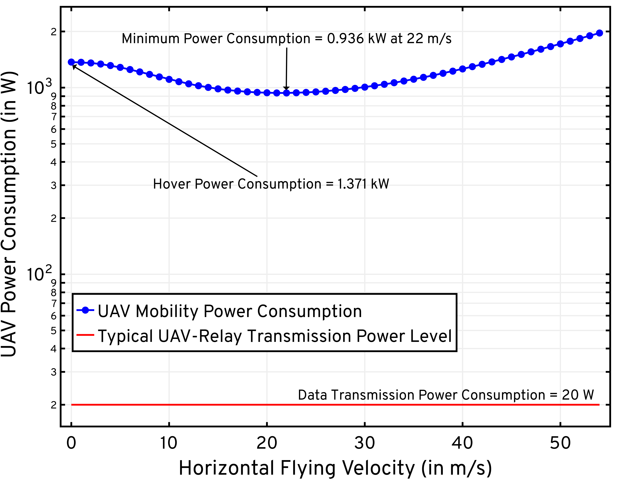
Tx power negligible relative to Mobility power
Optimizing UAV Mobility Power Consumption

Slide 8
State-of-the-art: Drawbacks
Control [1, 2, 3, 4]:
Non-adaptive: Deterministic traffic models
Approaches rely on Successive Convex Approximation (SCA):
Iterative optimization of non-convex problems via convex approximations at a local point
Involves prohibitively large policy convergence times
Channel Model [1,2,3,4]:
Inaccurately employ free space path-loss models
Fail to exploit the A2G channel characteristics
SCA: Approximations in data payload delivery constraints to enforce convexity
[1] Y. Zeng et al., “Energy Minimization for Wireless Communication With Rotary-Wing UAV,” IEEE Transactions on Wireless Communications, vol. 18, no. 4, pp. 2329–2345, April 2019.
[2] M. A. Abd-Elmagid and H. S. Dhillon, “Average Peak Age-of-Information Minimization in UAV-Assisted IoT Networks,” IEEE Transactions on Vehicular Technology, vol. 68, no. 2, pp. 2003–2008, 2019.
[3[ X. Hu et al., “UAV-Assisted Relaying and Edge Computing: Scheduling and Trajectory Optimization,” IEEE Transactions on Wireless Communications, vol. 18, no. 10, pp. 4738–4752, 2019
[4] C. You and R. Zhang, “3D Trajectory Optimization in Rician Fading for UAV-Enabled Data Harvesting,” IEEE Transactions on Wireless Communications, vol. 18, no. 6, pp. 3192–3207, 2019

Slide 9
State-of-the-art: Drawbacks
UAV Trajectory Design:
Static positioning [1,2,3]
SCA [4]: Approximations in mobility model constraints to enforce convexity
Restricted Mobility: Fixed forward flying velocity [4] | Impractical path structures [3]
Particle Swarm Optimization (PSO) [1,2,3] is inefficient (limited update scope) and computationally intractable
UAV Deployment:
Single UAV deployments are insufficient [1,2,3,4]
Centralized swarm control suffers from higher OPEX and CAPEX [5,6]
Joint multi-UAV constructions [7,8] lead to prohibitively large solution spaces
[1] H. Shakhatreh et al., “Efficient 3D placement of a UAV using particle swarm optimization,” in 2017 8th International Conference on Information and Communication Systems (ICICS), 2017, pp. 258–263.
[2] Z. Yuheng et al., “3-D Deployment Optimization of UAVs Based on Particle Swarm Algorithm,” in 2019 IEEE 19th International Conference on Communication Technology (ICCT), 2019, pp. 954–957.
[3] R. K. Patra, P. Muthuchidambaranathan, “Optimisation of Spectrum and Energy Efficiency in UAV-Enabled Mobile Relaying Using Bisection and PSO Method,” in 2018 International Conference for Convergence in Technology (I2CT), 2018, pp. 1–7.
[4] M. A. Abd-Elmagid and H. S. Dhillon, “Average Peak Age-of-Information Minimization in UAV-Assisted IoT Networks,” IEEE Transactions on Vehicular Technology, vol. 68, no. 2, pp. 2003–2008, 2019.
[5] Q. Wu et al., “Joint Trajectory and Communication Design for Multi-UAV Enabled Wireless Networks,” IEEE Transactions on Wireless Communications, vol. 17, no. 3, pp. 2109–2121, 2018.
[6] M. Mozaffari et al., “Efficient Deployment of Multiple Unmanned Aerial Vehicles for Optimal Wireless Coverage,” IEEE Communications Letters, vol. 20, no. 8, pp. 1647–1650, 2016.
[7] Q. Hu et al., “Low-Complexity Joint Resource Allocation and Trajectory Design for UAV-Aided Relay Networks With the Segmented Ray-Tracing Channel Model,” IEEE Transactions on Wireless Communications, vol. 19, no. 9, pp. 6179–6195, 2020.
[8] A. E. A. A. Abdulla et al., “Toward Fair Maximization of Energy Efficiency in Multiple UAS-Aided Networks: A Game-Theoretic Methodology,” IEEE Transactions on Wireless Communications, vol. 14, no. 1, pp. 305–316, Jan 2015.

Slide 10
Our Contributions: Addressing the drawbacks
Adaptive Control:
UAVs relay dynamically-generated traffic from randomly distributed GNs
Semi-Markov Decision Process (SMDP) formulation captures temporal irregularities in state transitions
A2G Channel Model:
Accurately model A2G channel characteristics along BS-UAV and GN-UAV links
Incorporation of rate-adaptation at all transmitters to maximize system throughput

Slide 11
Our Contributions: Addressing the drawbacks
UAV Trajectory Design:
Competitive Swarm Optimization (CSO)
Unlike SCA, CSO does not rely on a specific problem structure
Unlike PSO, CSO has more efficient updates via pair-wise competition
Distributed Swarm Deployments:
Decoupled executions via policy replication across the swarm
Overlay a fully-connected mesh network for command & control
Multi-UAV heuristics for spread maximization and conflict resolution

Slide 12
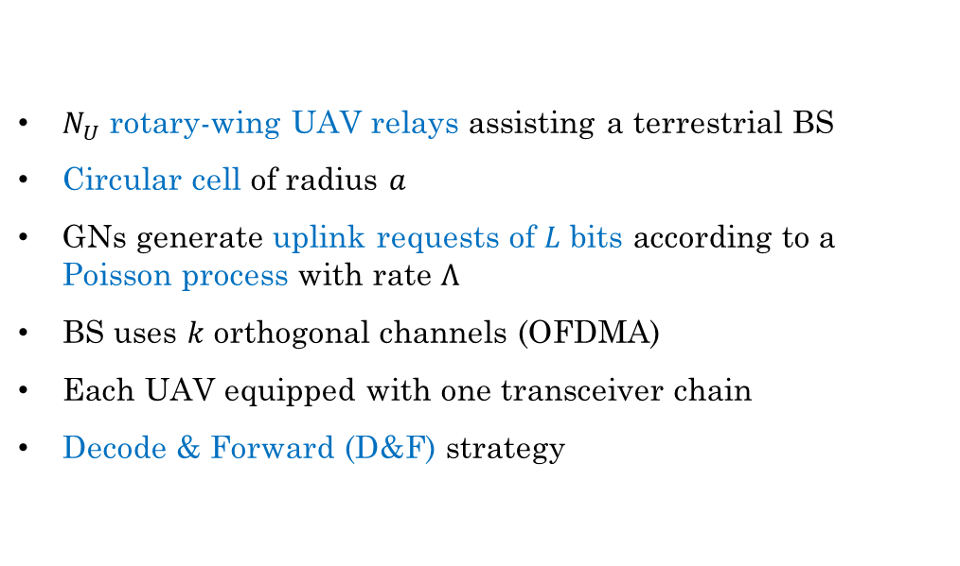
System Model: Deployment
$N_{U}$ rotary-wing UAV relays assisting a terrestrial BS
Circular cell of radius $a$
GNs generate uplink requests of $L$ bits according to a Poisson process with rate $Λ$
BS uses $k$ orthogonal channels (OFDMA)
Each UAV equipped with one transceiver chain
Decode & Forward (D&F) strategy

Slide 13
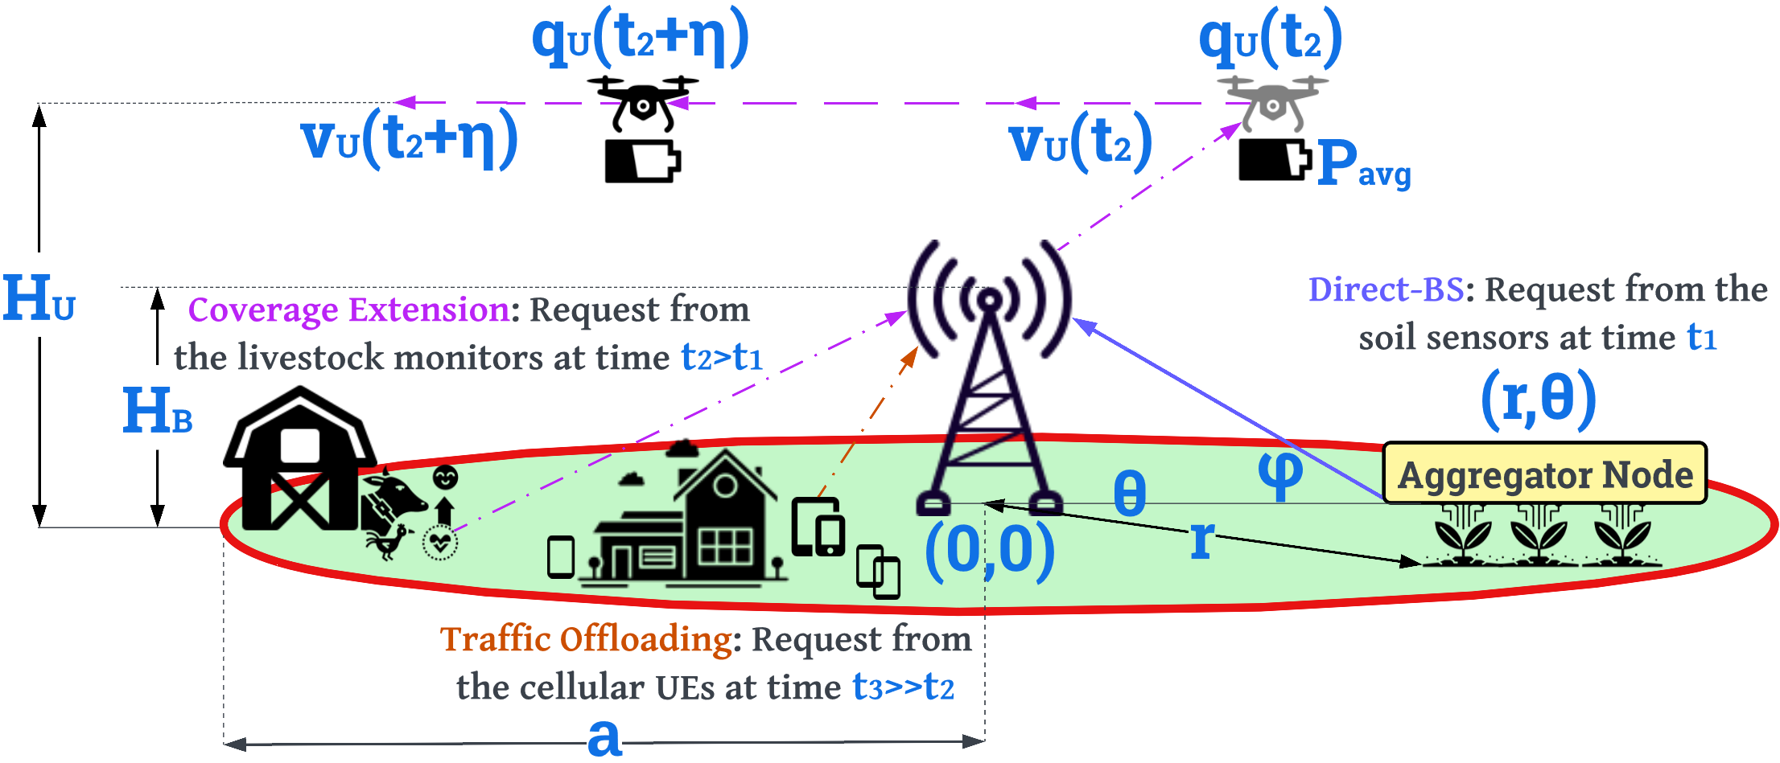
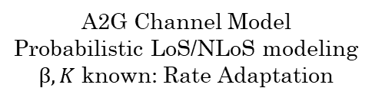
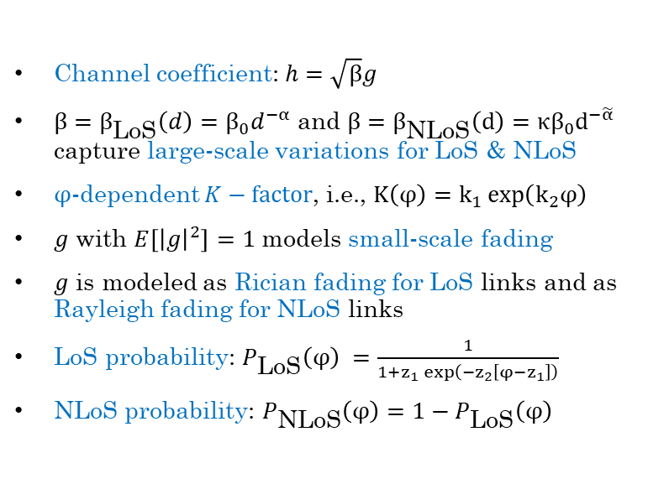
System Model: Channel
Channel coefficient: $h=\sqrt{β}g$
$β=β_{\text{LoS}}\left(d\right)=β_{0}d^{−α}$ and $β=β_{\text{NLoS}}\left(d\right)=κβ_{0}d^{−\tilde{α}}$ capture large-scale variations for LoS & NLoS
$φ$-dependent $K−factor$, i.e., $K\left(φ\right)=k_{1}\exp\left(k_{2}φ\right)$
$g$ with $E\left[{\left|g\right|}^{2}\right]=1$ models small-scale fading
$g$ is modeled as Rician fading for LoS links and as Rayleigh fading for NLoS links
LoS probability: $P_{\text{LoS}}\left(φ\right) =\frac{1}{1+z_{1}\exp\left(−z_{2}\left[φ−z_{1}\right]\right)}$
NLoS probability: $P_{\text{NLoS}}\left(φ\right)=1−P_{\text{LoS}}\left(φ\right)$
A2G Channel Model
Probabilistic LoS/NLoS modeling
$β, K$ known: Rate Adaptation
[1] C. You and R. Zhang, “3D Trajectory Optimization in Rician Fading for UAV-Enabled Data Harvesting,” IEEE Transactions on Wireless Communications, vol. 18, no. 6, pp. 3192–3207, 2019.
[2] A. Al-Hourani, S. Kandeepan, and S. Lardner, “Optimal LAP Altitude for Maximum Coverage,” IEEE Wireless Communications Letters, vol. 3, no. 6, pp. 569–572, 2014.
[3] D. Tse and P. Viswanath, Fundamentals of Wireless Communication. Cambridge: Cambridge University Press, 2005.
[4] R. Essaadali and A. Kouki, “A new simple Unmanned Aerial Vehicle doppler effect RF reducing technique,” in MILCOM 2016 - 2016 IEEE Military Communications Conference, 2016, pp. 1179–1183.

Slide 14
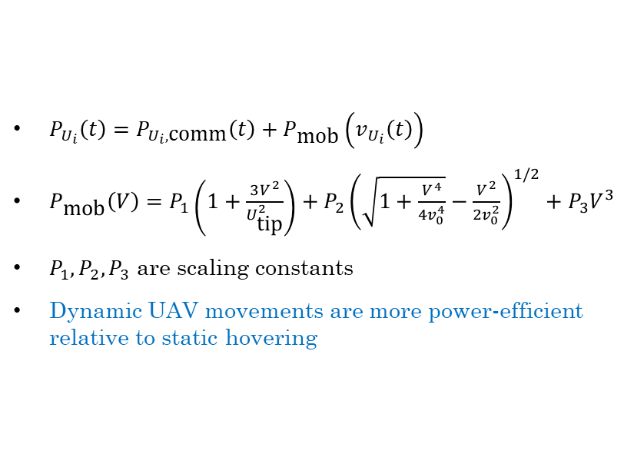
System Model: Power
$P_{U_{i}}\left(t\right)=P_{U_{i},\text{comm}}\left(t\right)+P_{\text{mob}}\left(v_{U_{i}}\left(t\right)\right)$
$P_{\text{mob}}\left(V\right)=P_{1}\left(1+\frac{3V^{2}}{U_{\text{tip}}^{2}}\right)+P_{2}{\left(\sqrt{1+\frac{V^{4}}{4v_{0}^{4}}}−\frac{V^{2}}{2v_{0}^{2}}\right)}^{1/2}+P_{3}V^{3}$
$P_{1},P_{2},P_{3}$ are scaling constants
Dynamic UAV movements are more power-efficient relative to static hovering
Negligible relative to Mobility power usage
[1] Y. Zeng et al., “Energy Minimization for Wireless Communication With Rotary-Wing UAV,” IEEE Transactions on Wireless Communications, vol. 18, no. 4, pp. 2329–2345, April 2019.

Slide 15
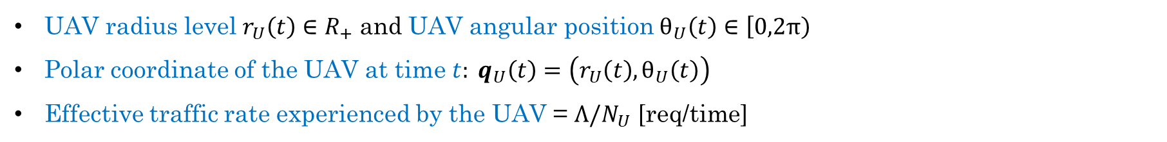
The Single-Agent Specialization
Restricting our generalized system model to a single UAV to find the optimal control policy
Later, extended to multiple UAVs
UAV radius level $r_{U}\left(t\right)∈R_{+}$ and UAV angular position $θ_{U}\left(t\right)∈\left[0,2π\right)$
Polar coordinate of the UAV at time $t: q_{U}\left(t\right)=\left(r_{U}\left(t\right),θ_{U}\left(t\right)\right)$
Effective traffic rate experienced by the UAV = $Λ/N_{U}$ [req/time]

Slide 16
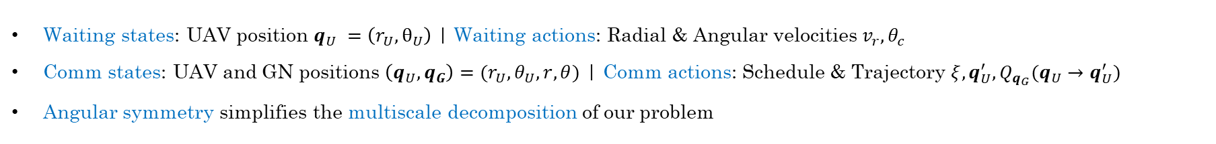
SMDP Formulation: States & Actions
Waiting states: UAV position $q_{U} =\left(r_{U},θ_{U}\right)$ | Waiting actions: Radial & Angular velocities $v_{r}, θ_{c}$
Comm states: UAV and GN positions $\left(q_{U}, q_{G}\right)=(r_{U}, θ_{U}, r, θ)$ | Comm actions: Schedule & Trajectory $ξ, {q_{U}^{′}, Q}_{q_{G}}(q_{U}→q_{U}^{′})$
Angular symmetry simplifies the multiscale decomposition of our problem

Slide 17
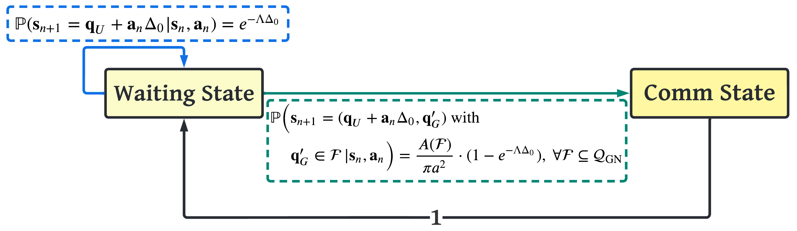
SMDP Formulation: Transition Model

Slide 18
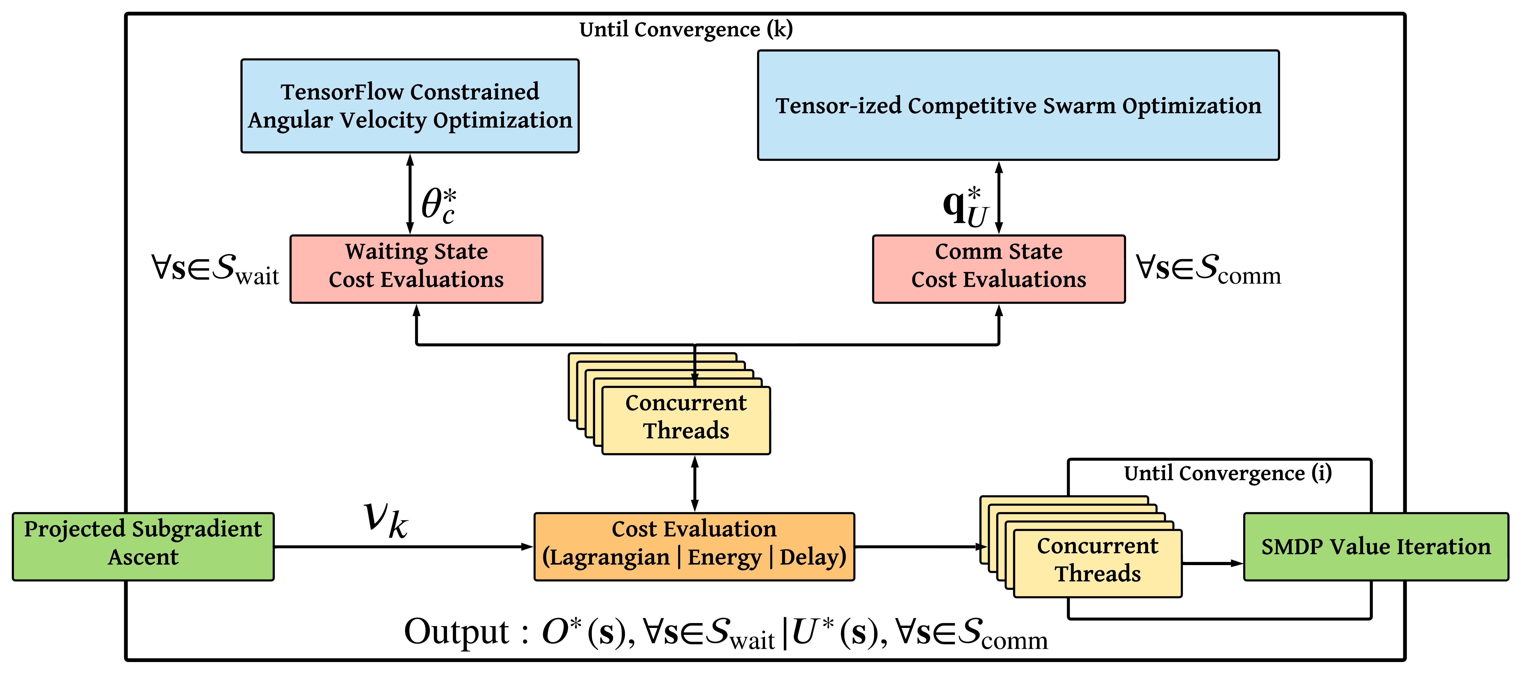
Waiting state optimization tasks
Comm state optimization tasks
Algorithmic Flow of the single-agent optimization process

Slide 19
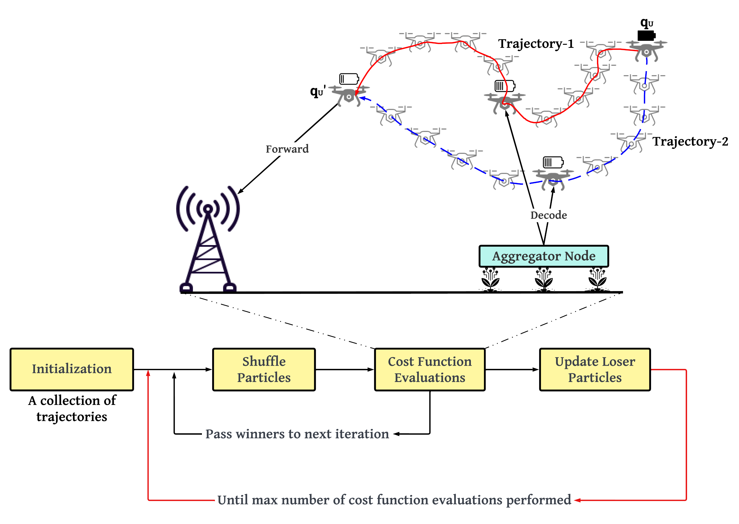
Each trajectory is a series of waypoints and velocities
Movement in the x-y plane at a fixed height $H_{U}$
End Position for both trajectories
(obtained from SMDP Value Iteration)
Start Position for both trajectories
(from the current comm state)
Time & Energy Lagrangian (cost) comparison between these trajectories
Pair-wise competition between two trajectories
Update in the direction of the winners and the global mean
Algorithmic Flow of the CSO Trajectory Design process

Slide 20
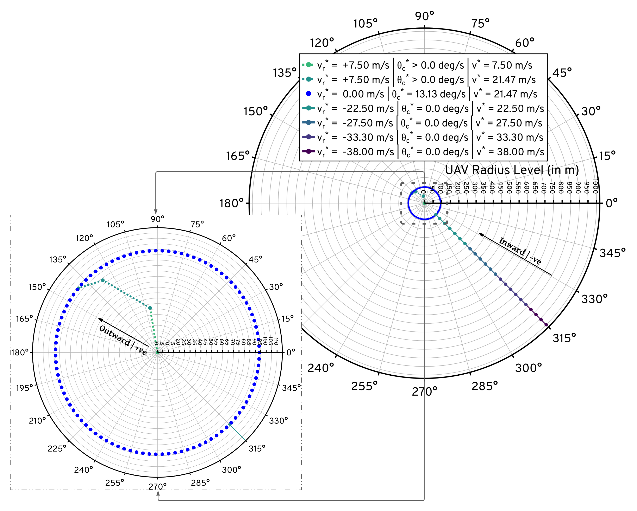
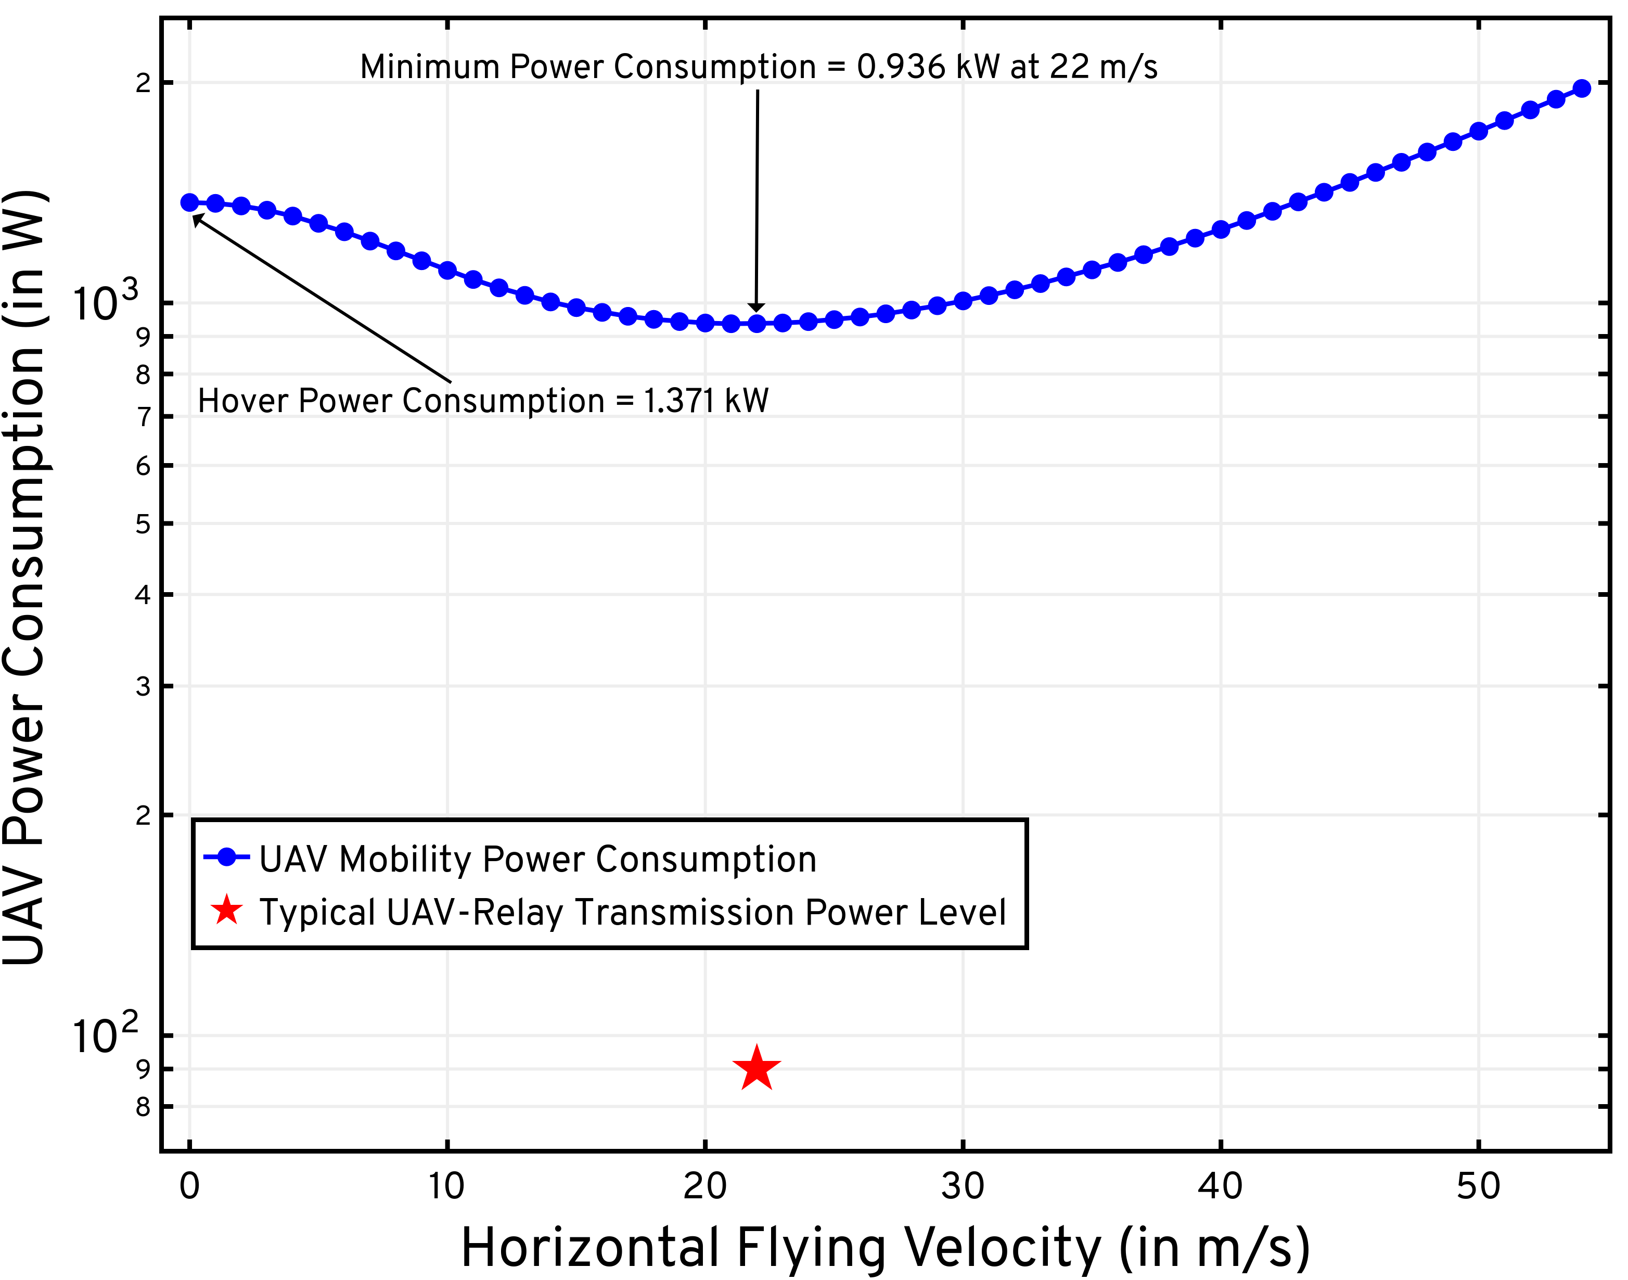
Optimal radial velocity obtained via SMDP Value Iteration
Given this radial velocity action, angular velocity obtained via minimization of mobility power consumption
Zoomed-in version
To minimize mobility power consumption, the UAV waits at ~95 m radius level
Optimal Waiting Policy Visualization: $L=1$ Mb

Slide 21
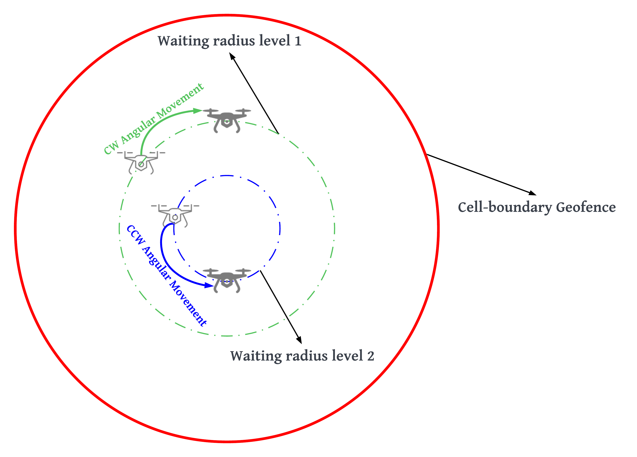
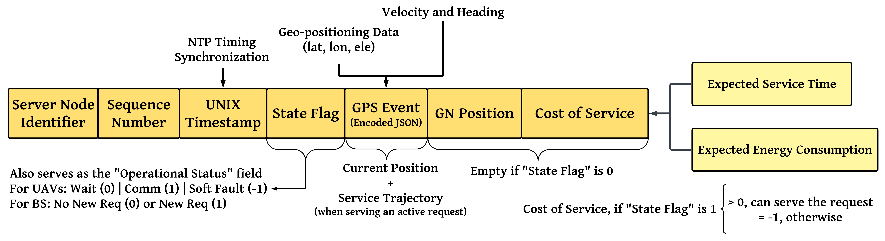
Extension to UAV Swarms
The single-UAV SMDP optimal wait policy is augmented with spread maximization and
replicated across all the UAVs in the swarm
UAVs waiting in a particular radius level at the optimal velocity according to the derived policy
These UAVs share control frames amongst each other over the command-and-control network
Not relevant for waiting states
Maximize the angular spread by controlling
CW/CCW angular movements
The objective here is to better position and prime the waiting UAVs for potential new requests

Slide 22
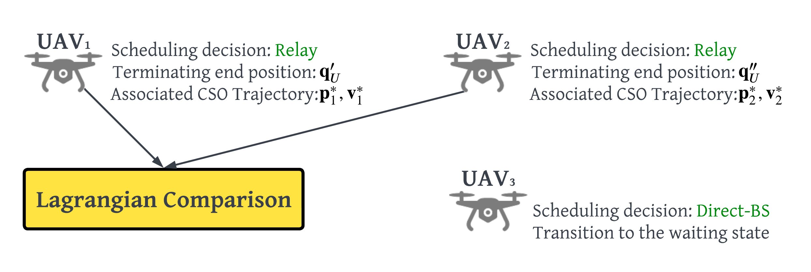
Extension to UAV Swarms
The single-UAV SMDP optimal comm policy is augmented with conflict resolution and
replicated across all the UAVs in the swarm
UAVs with “Direct-BS” as their optimal scheduling decision will not take part in the consensus-driven conflict resolution process
Waiting UAVs enter the comm state when a new request arises from a GN in the cell
Resolve conflict by choosing the node with the smallest Lagrangian (delay & energy cost)
If the optimal scheduling action is to provide relayed-service to the GN, then the UAVs share their Lagrangians over the command-and-control network
Share GN position & Lagrangian
The objective here is to resolve the conflicts among UAVs that “decide” to serve the GN request

Slide 23
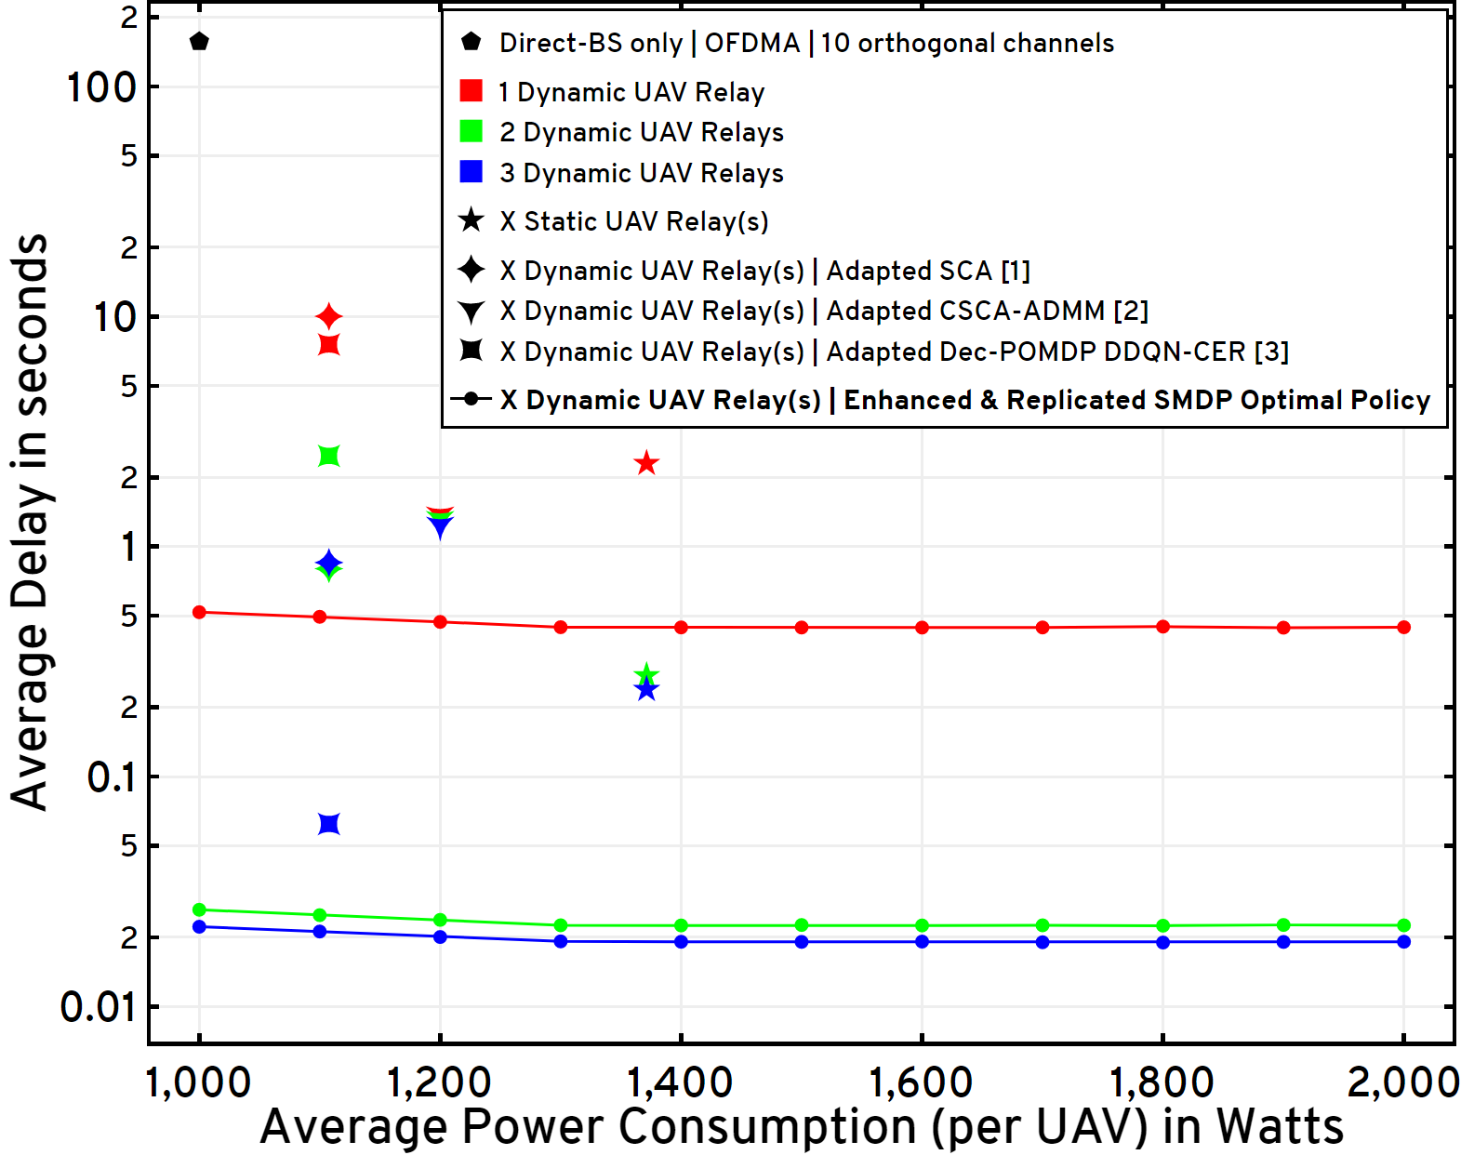

Data Payload Size = 1 Mb | BW = 5 MHz | Arrival Rate = 1 request every minute | 10,000 requests from 300 GNs
BS at (0,0) | BS Height = 80 m | UAV Height = 200 m | UAV Hover Power Consumption = 1.37 kW
62% faster
Across all comparisons, note our advantage vis-à-vis energy efficiency as well as service times
11x faster
2x faster
Average delay for the GNs versus per-UAV average power constraint
[1] Y. Zeng et al., “Energy Minimization for Wireless Communication With Rotary-Wing UAV,” IEEE Transactions on Wireless Communications, vol. 18, no. 4, pp. 2329–2345, April 2019.
[2] Q. Wu et al., “Joint Trajectory and Communication Design for Multi-UAV Enabled Wireless Networks,” IEEE Transactions on Wireless Communications, vol. 17, no. 3, pp. 2109–2121, 2018.
[3] H. Bayerlein et al., “Multi-UAV Path Planning for Wireless Data Harvesting With Deep Reinforcement Learning,” IEEE Open Journal of the Communications Society, vol. 2, p. 1171–1187, 2021.

Slide 24
Conclusion
Dynamic traffic | A2G channel model with Rate-Adaptation
Specialized to single-relay constructions via an SMDP formulation | Trajectory design via CSO
Supplemented with multi-UAV heuristics: Spread Maximization | Conflict Resolution
Performance comparisons with relevant schemes in the state-of-the-art as well as with policy-driven heuristics

